Slide 1

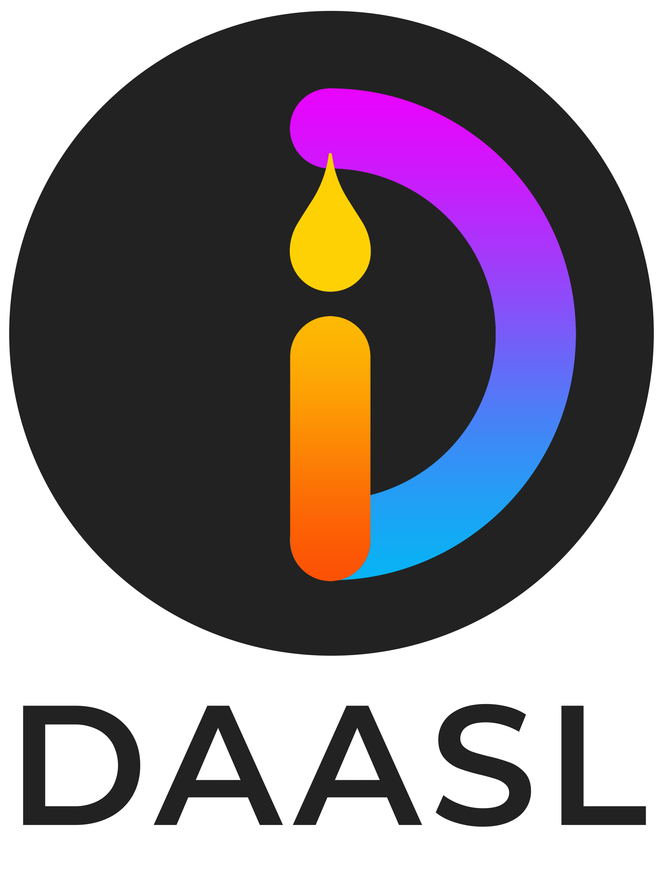
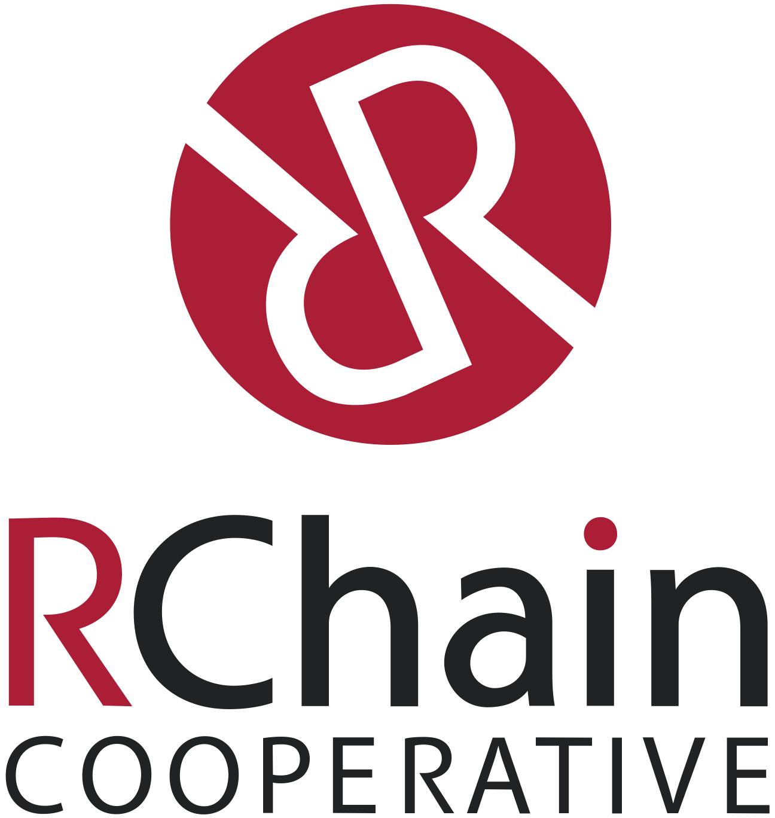
Rchain Equity Model + Business development
Lucius Gregory Meredith

Slide 2




What Are We Offering?
We are offering an opportunity to invest in a for profit organization called DAASL which today is wholly owned by the RChain Cooperative. DAASL will provide:
Decentralized DevOps services to keep the light on for all the Dapps running on the RChain blockchain.
A toolkit to accelerate the rapid construction, monitoring and execution of Dapps.
Included in that toolkit today are:
A decentralized platform for mass deliberation called RChat
A decentralized voting capability called RVote
A generic wrapper for managing any digital content on RChain called Rcat
What we want to build (we have the designs) are:
A globally scalable sponsored content framework for empowered advertising (RAd)
A unifying API for predictive analytics that can be applied to RChain data and any other blockchain
RChat
RVote
RCat
RAd

Slide 3
What Are We Offering?
DAASL is a separate organization to the RChain.coop in which DAASL owns 15M shares in itself and RChain owns the remaining 10M shares
The total DAASL tokens minted by DAASL is 1 billion of which RChain has 500M and DAASL has 500M tokens.
The investment sought is for $10M over a period of 2 years in exchange for 20% of the equity valuing DAASL at (<current value> + $10M for post investment valuation).
For every $1 raised 50c goes to RChain in exchange for DAASL tokens at an agreed price, thus the remaining $5M is used to fund the DAASL to cashflow breakeven.
The opportunity can be taken by a single investor or many investors in blocks of$100K as long as the investor is a member of the RChain.coop (which is a minimal annual fee).

Slide 4
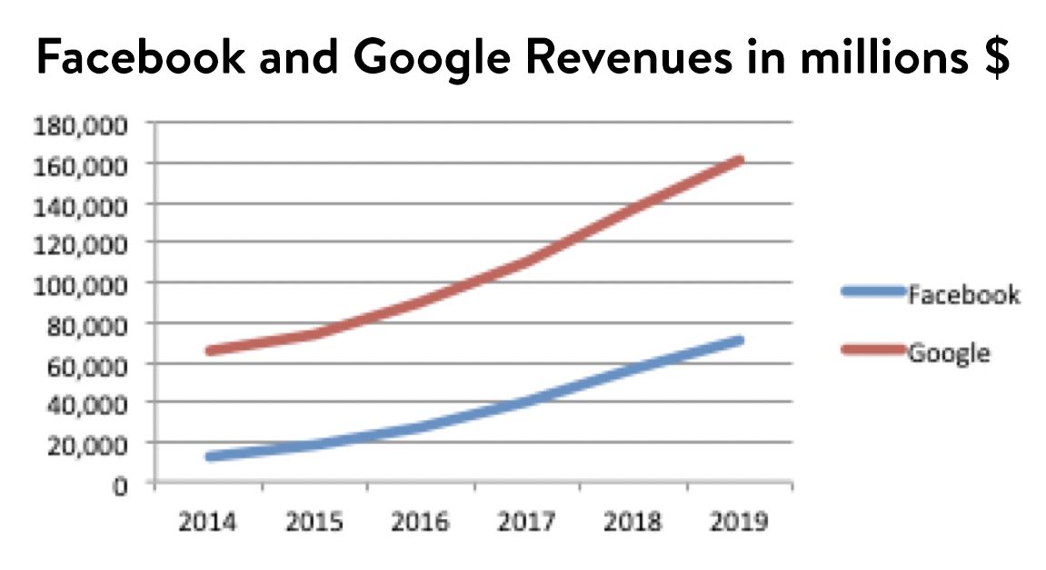
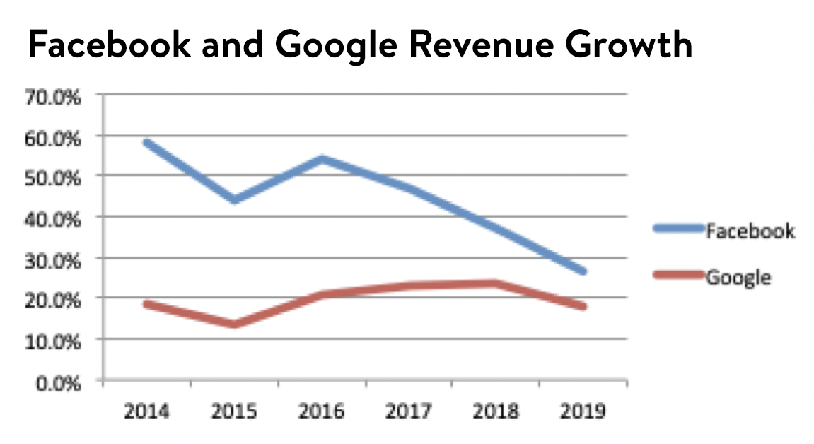
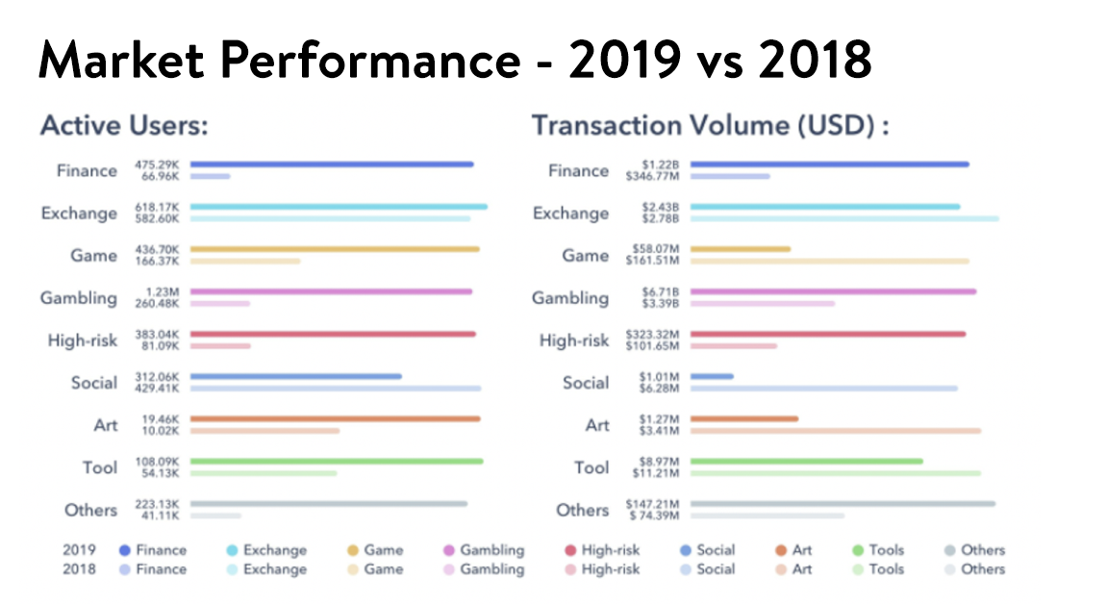
What Are We Offering?
Decentralized sponsored content
A globally scalable sponsored content framework for empowered advertising (called Rad-vertising) that executes on RChain’s blockchain able to deliver trusted sponsored content
Unifying API to enable any DApp on any platform to leverage sponsored content
RAd will return value to the content viewer shared with the DApp provider
RAd

Slide 5
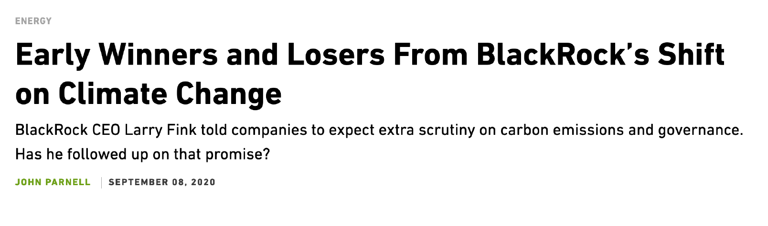
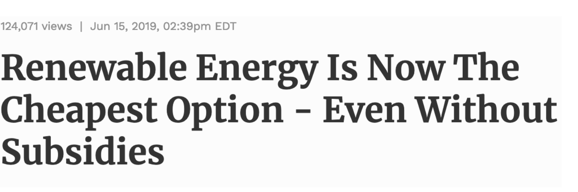
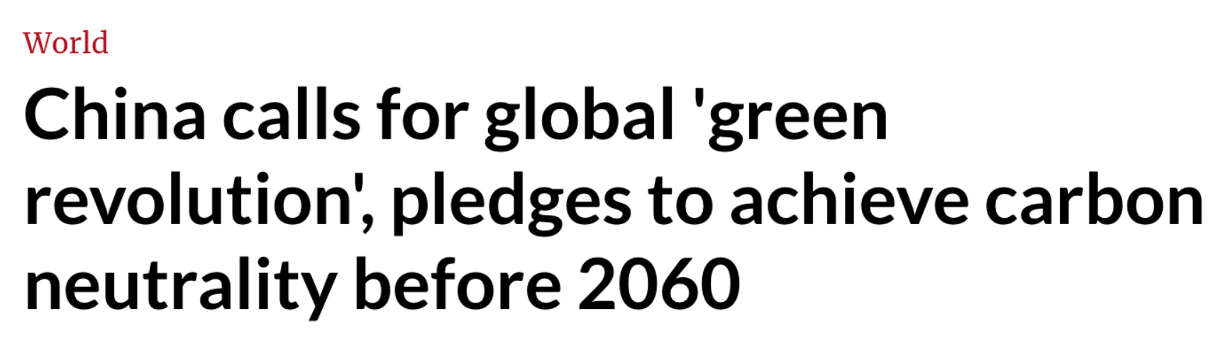





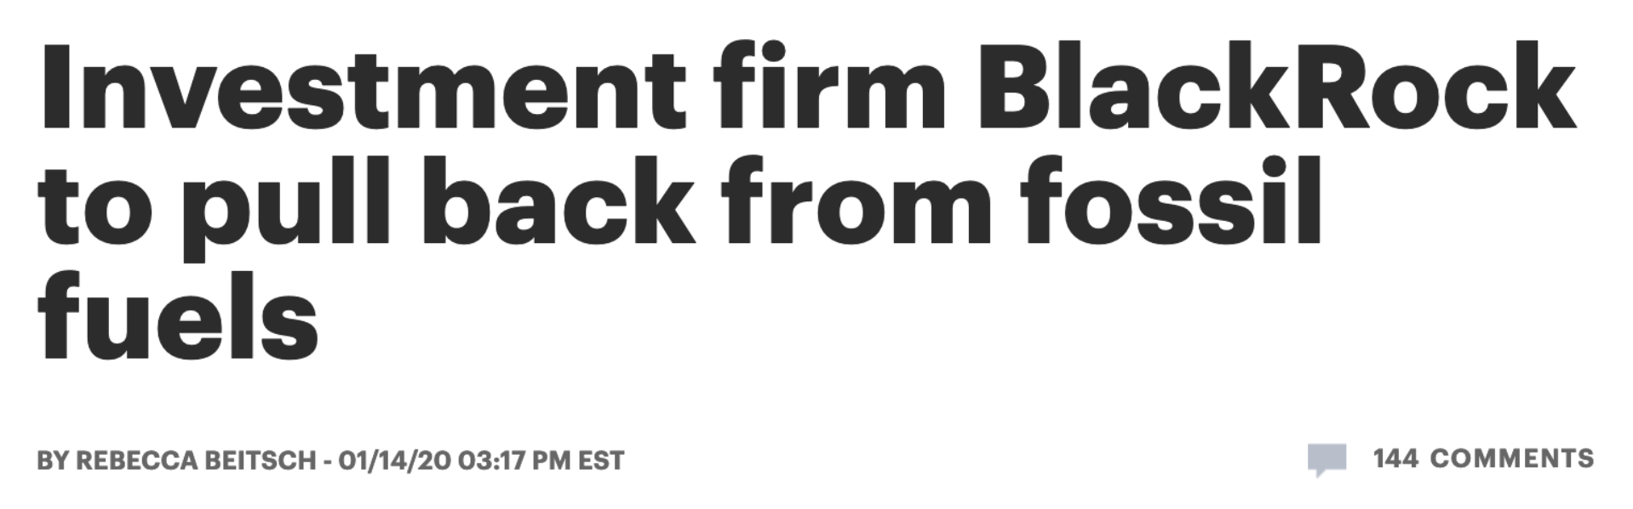


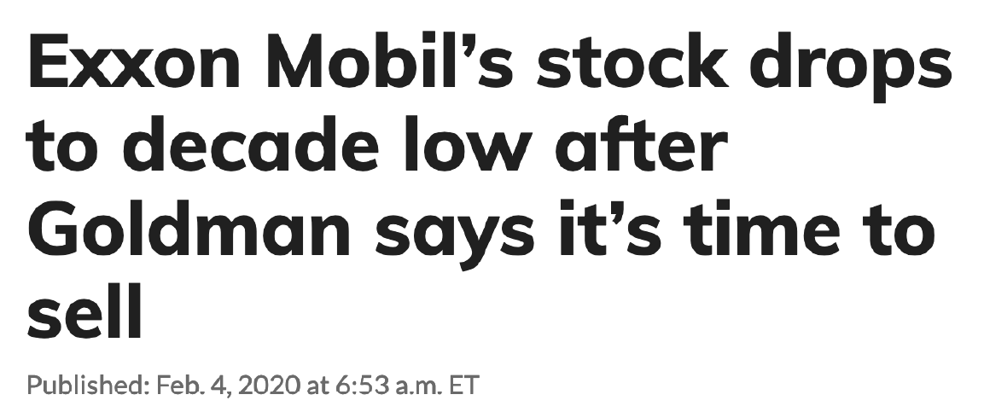


We are at a turning point …
Peak oil
It is no accident that this is happening at the same time we are seeing the inﬂection point in the fossil fuel economy.

Slide 6
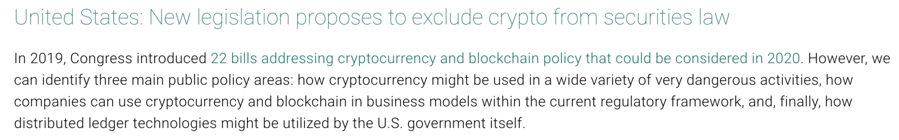


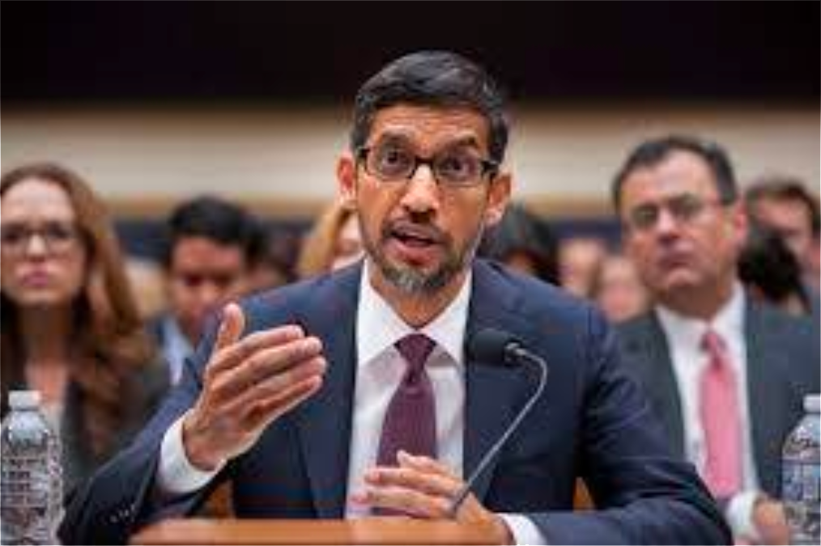
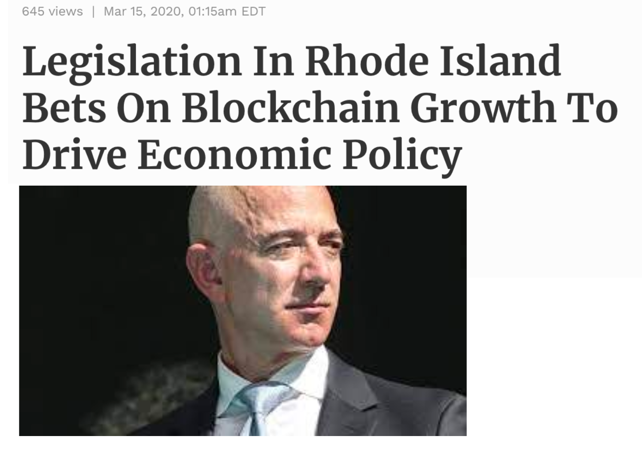
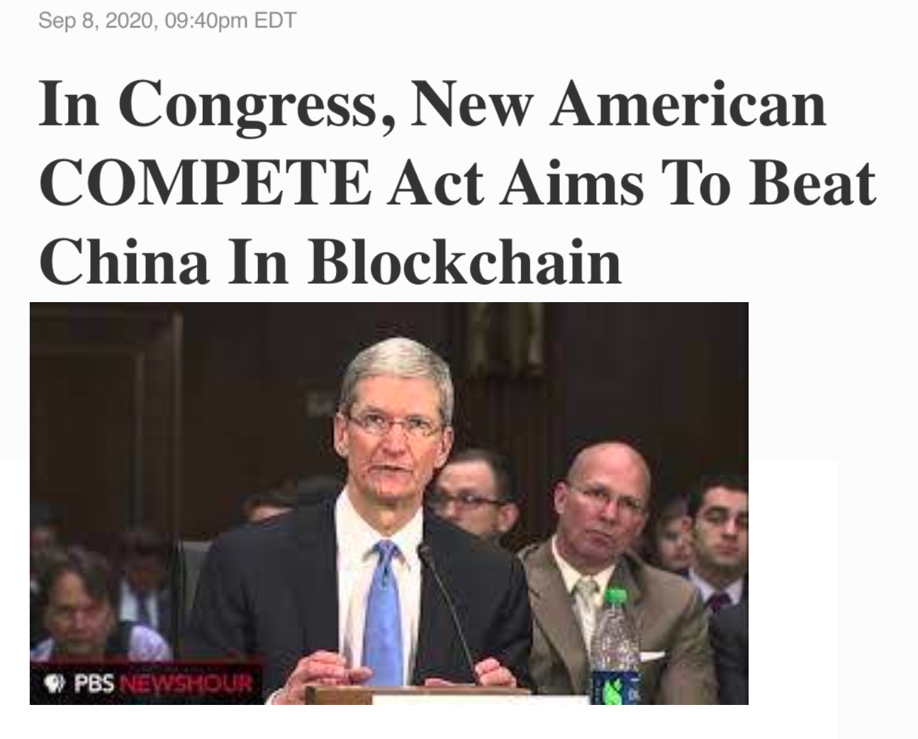
We are at a turning point …
Peak centralization
At the same time the US is hauling the CEOs of the big digital asset companies to testify they are moving toward embracing decentralized technologies. The two go hand in hand.

Slide 7






The internet is being re-factored
Which presents an opportunity to decentralize
It is inexorably moving from centralized control by a few major companies to decentralized applications serving decentralized communities.
Blockchain is playing a major role in that.
To make this real, organizations must step up and recreate and reimagine vital social and telecommunication services in a decentralized manner.

Slide 8
The Solution Space
Blockchains like RChain that have bet on high transaction volumes to make the network viable cannot simply wait for the community to build these applications.
They must seed the space with applications that simultaneously fulfill their own organizational requirements.
Governance communications are a prime example. Together with its community, RChain is building RChat and RVote.
These applications provide a decentralized chat, and voting mechanism, respectively.
Built from a combination of RChain as the backend, and off the shelf tools for the frontend, they provide not only key infrastructure for the community that governs the protocol, but templates for other apps to use to accelerate their development.

Slide 9
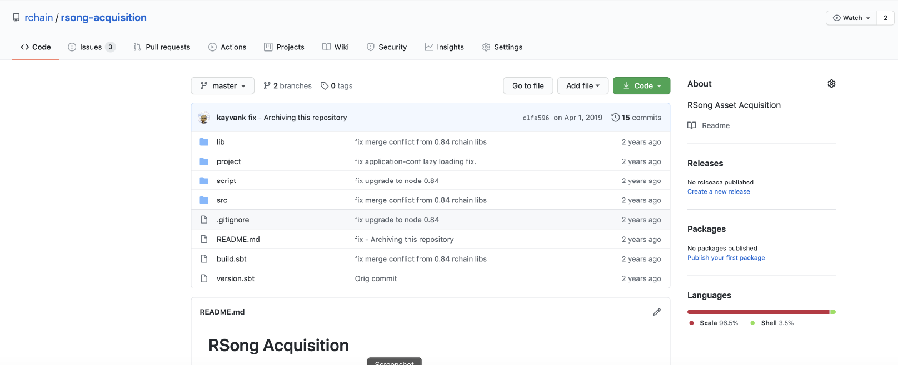
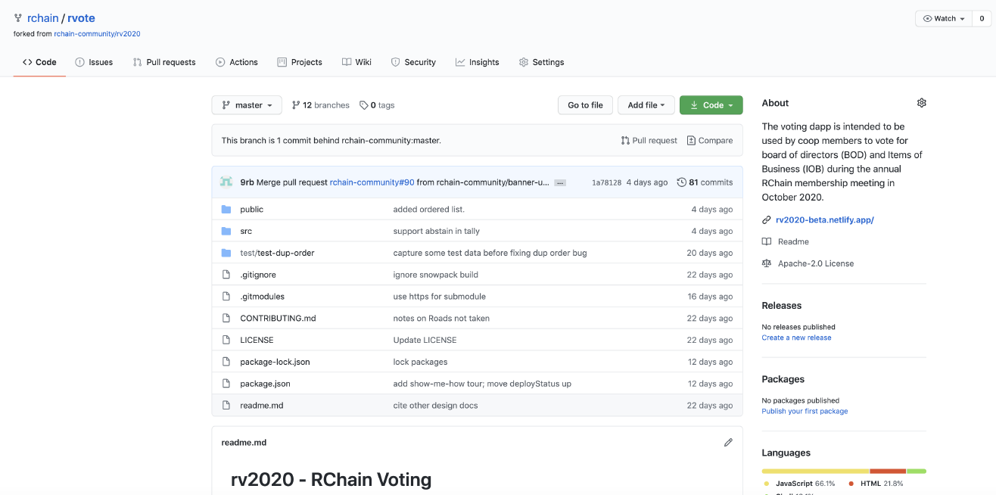
The Solution Space
These applications provide a decentralized digital asset management, messaging (chat), polling and voting mechanism, etc.
Built from a combination of RChain as the backend, and off the shelf tools for the frontend, they provide not only key infrastructure for the community that governs the protocol, but templates for other apps to use to accelerate their development.
RVote
RAd
RCat
RChat

Slide 10
The Solution Space
Building a dApp, however, is not the same as keeping it running 24/7.
Nor is it the same as a commitment to upgrade existing features or roll out new features as community use inexorably provides new requirements.
Redhat, MySQL, and many other open source projects have demonstrated a very convincing software as a service model that monetizes DevOps, maintenance, and feature development.

Slide 11
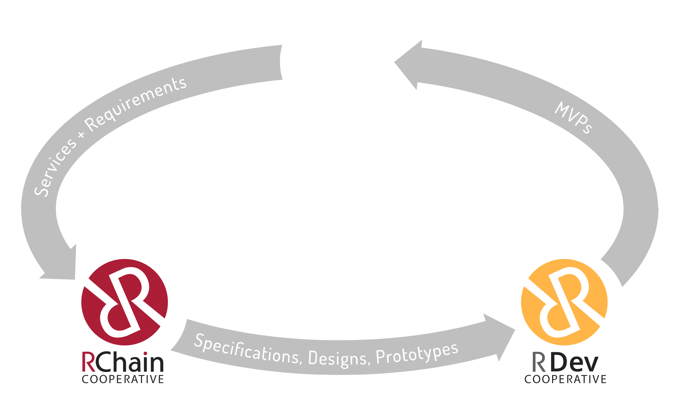
The RChain Eco-System
Think of RDev as the builder/contractor, and DAASL as the property management.
—Rao Bhamidipati

Slide 12
The RChain Eco-System
A for-profit DAASL shop built to
manage/maintain services
built on RChain and
other chains
Think of RDev as the builder/contractor, and DAASL as the property management.
—Rao Bhamidipati
A worker's coop
aimed at supporting
existing development
efforts as well as
providing delivery
resources for new
internal/external dApp ideas

Slide 13
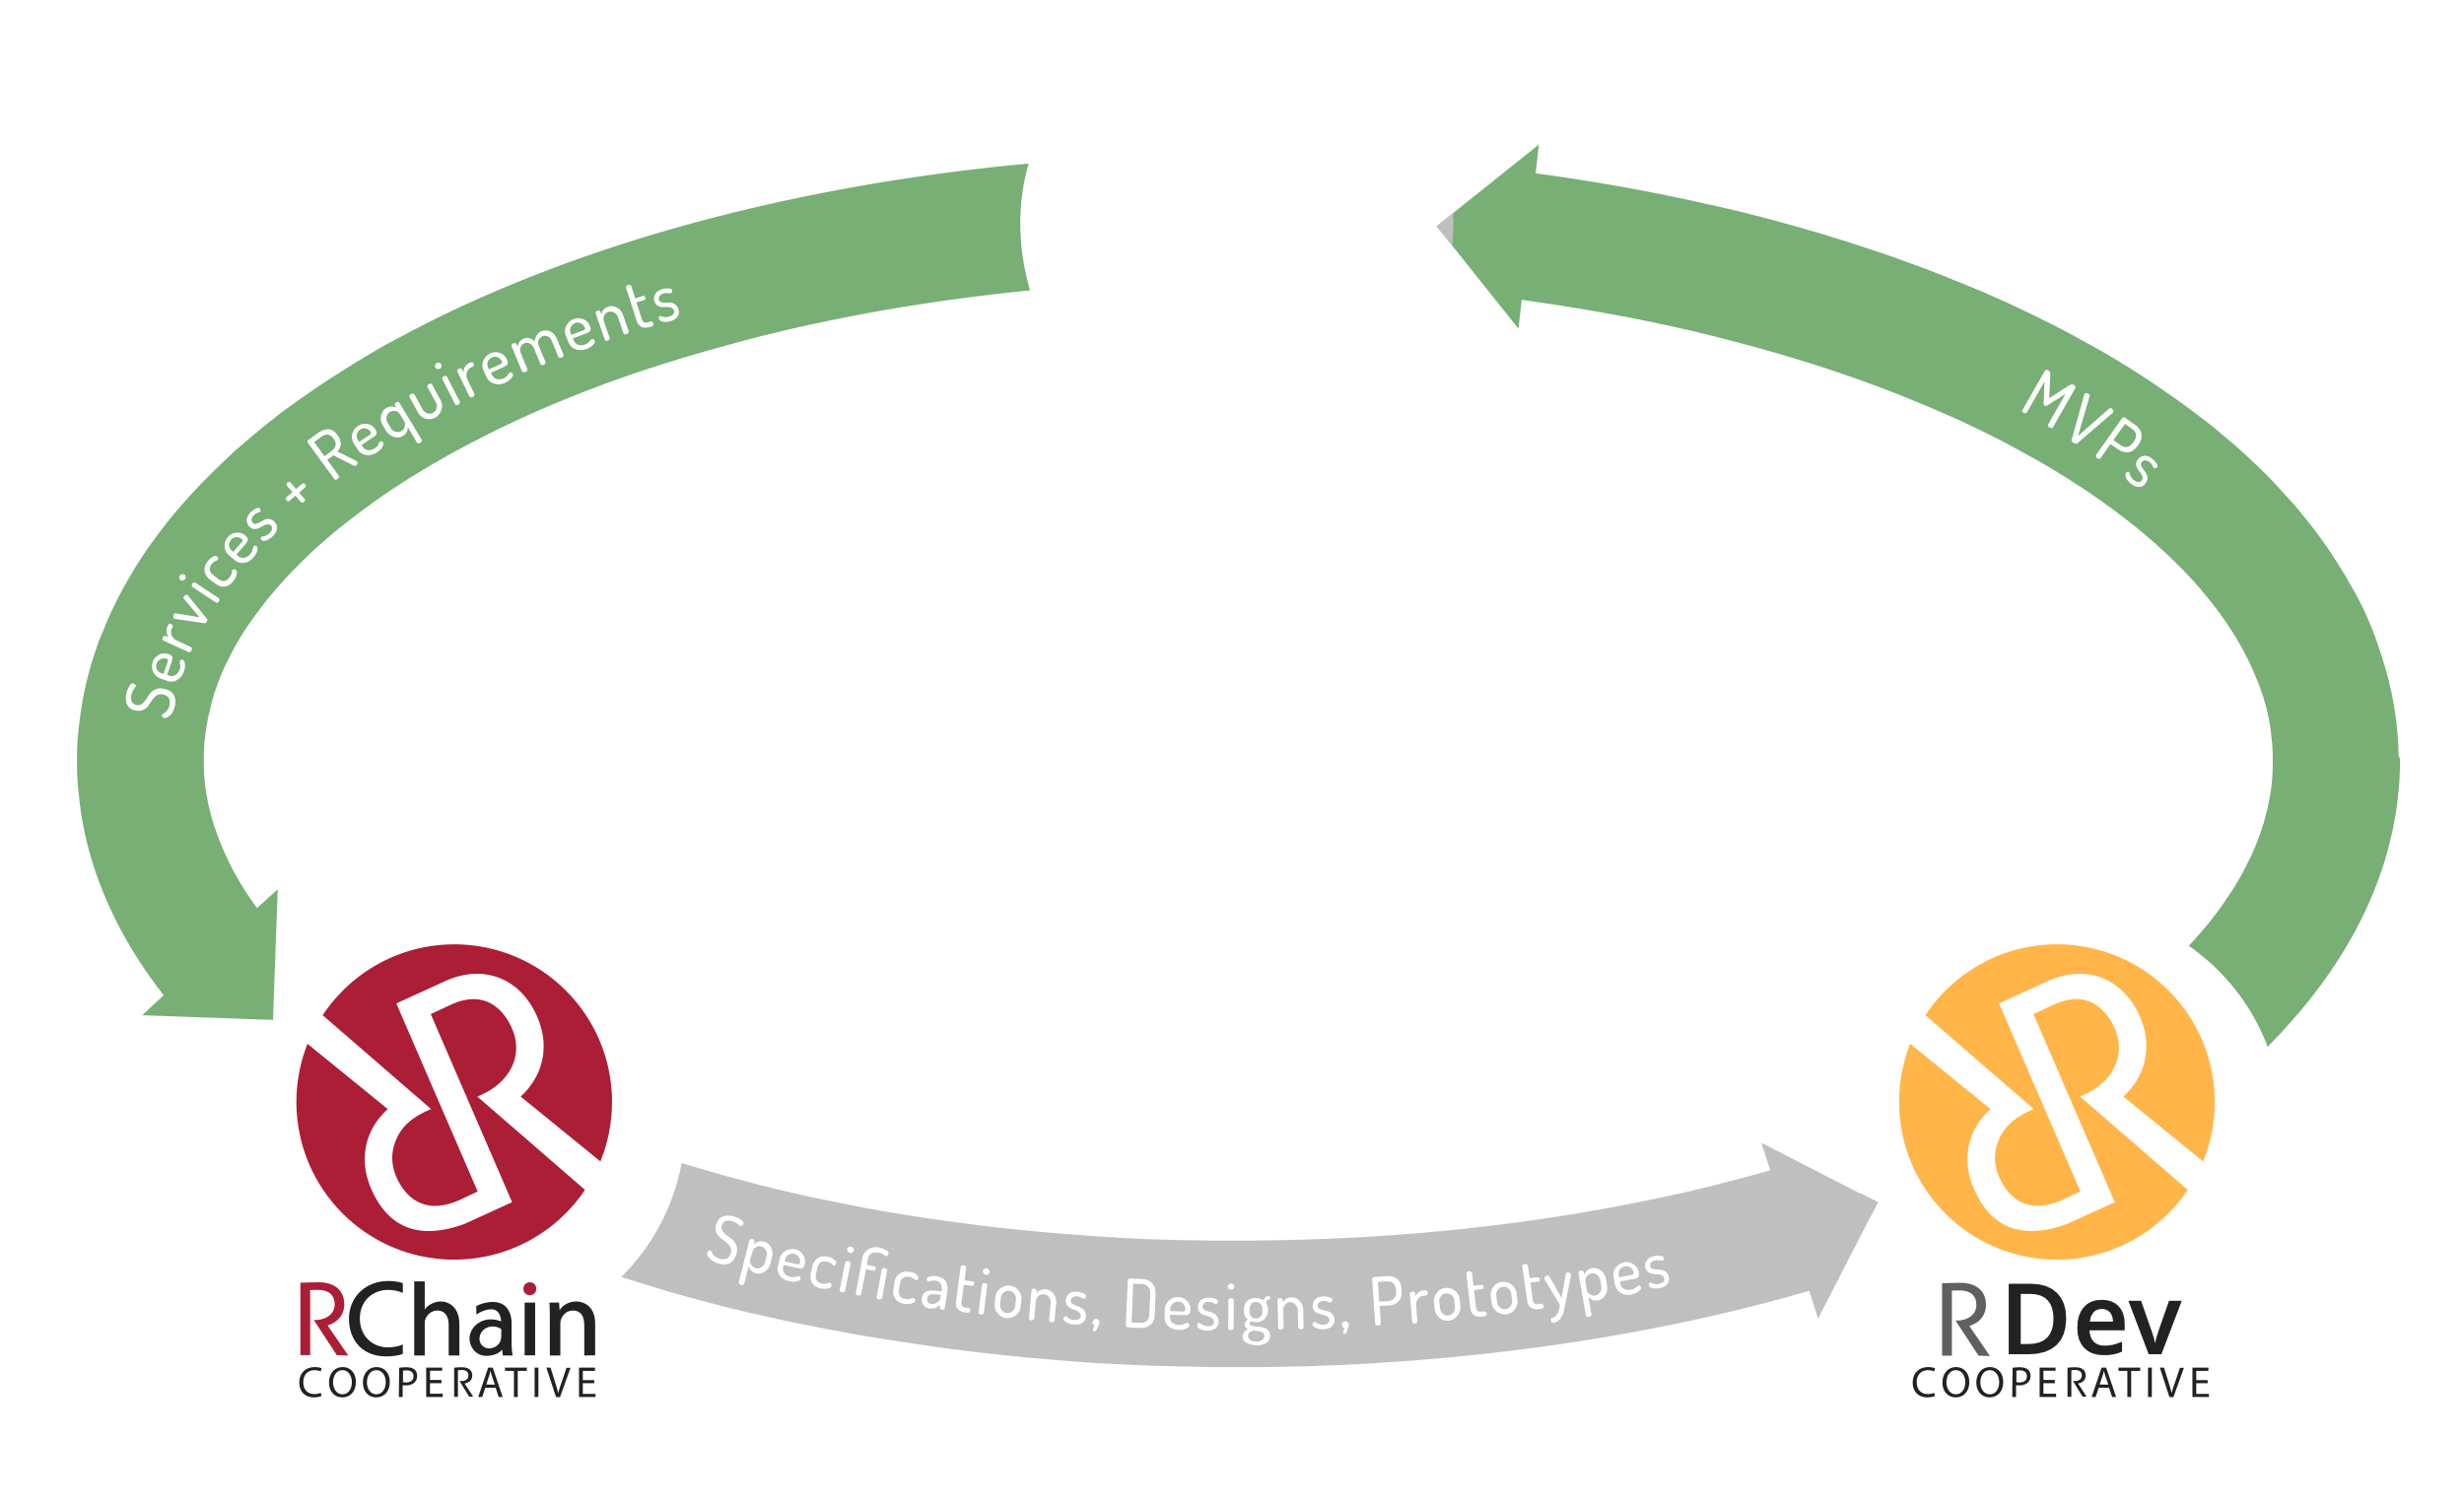
The RChain Eco-System
A for-profit DAASL shop built to
manage/maintain services
built on RChain and
other chains
Pays a portion of its revenue stream
to the inventors/developers
of the services they run
% Revenue
streams for
services
designed
by coop
% Revenue
streams for
services
developed
by RDev
Think of RDev as the builder/contractor, and DAASL as the property management.
—Rao Bhamidipati
A worker's coop
aimed at supporting
existing development
efforts as well as
providing delivery
resources for new
internal/external dApp ideas

Slide 14
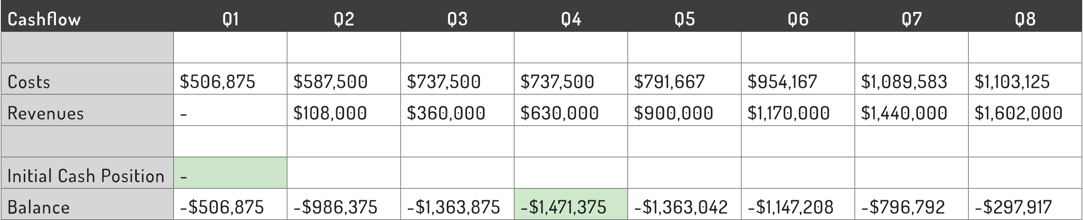
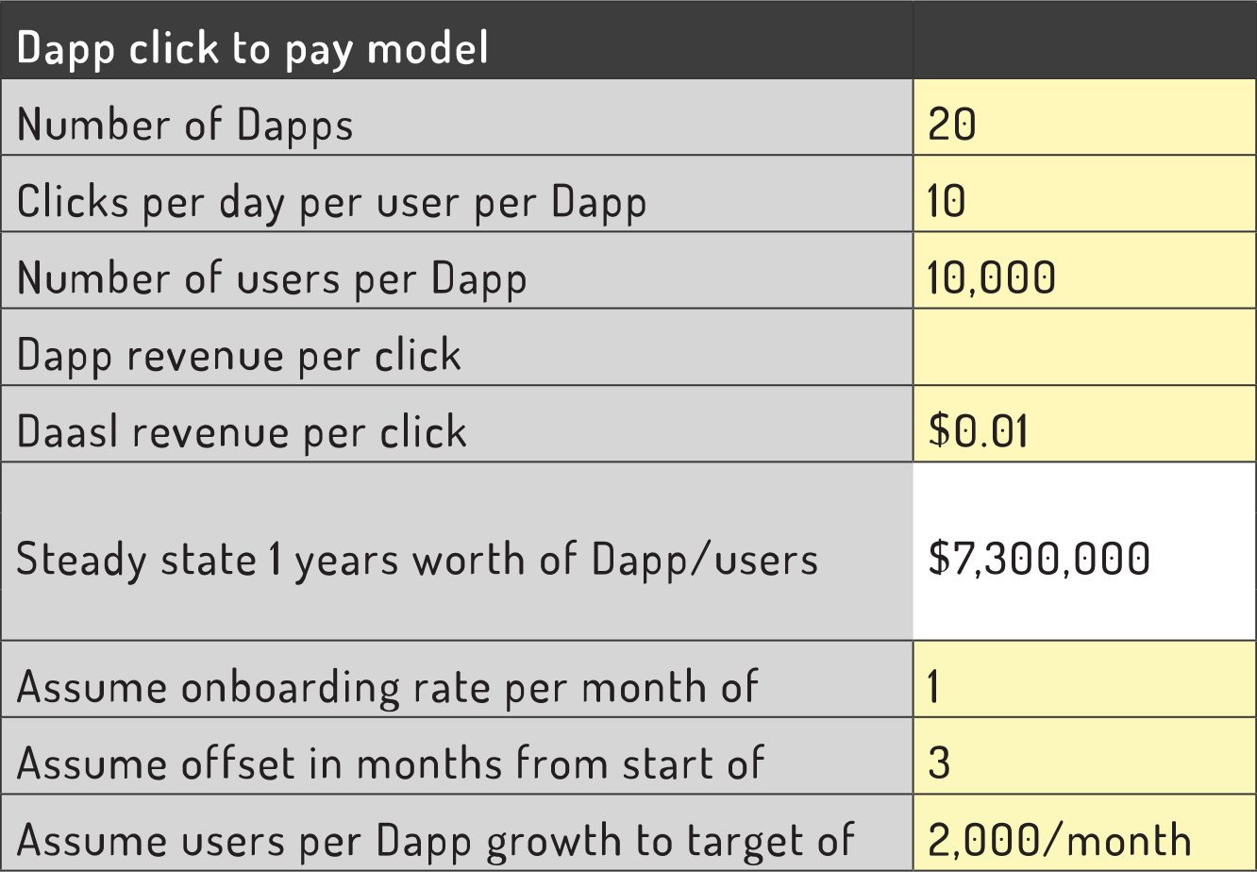
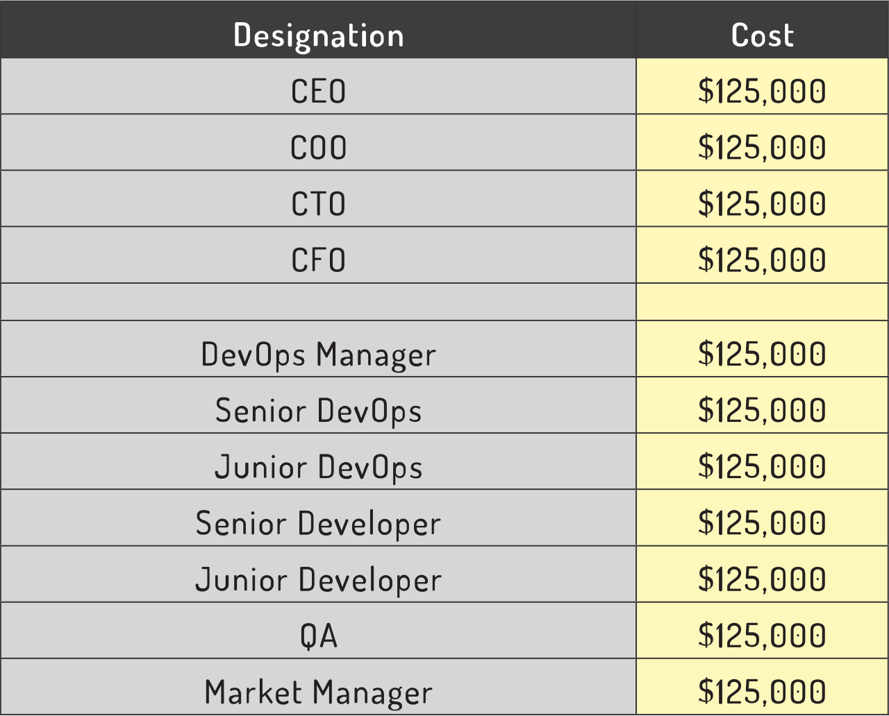
Economic Modeling Assumptions
Cashflow
$4.8 MILLION
PROFIT/YEAR
This is a much bigger profit ratio than standard SaaS models
Assumptions

Slide 15
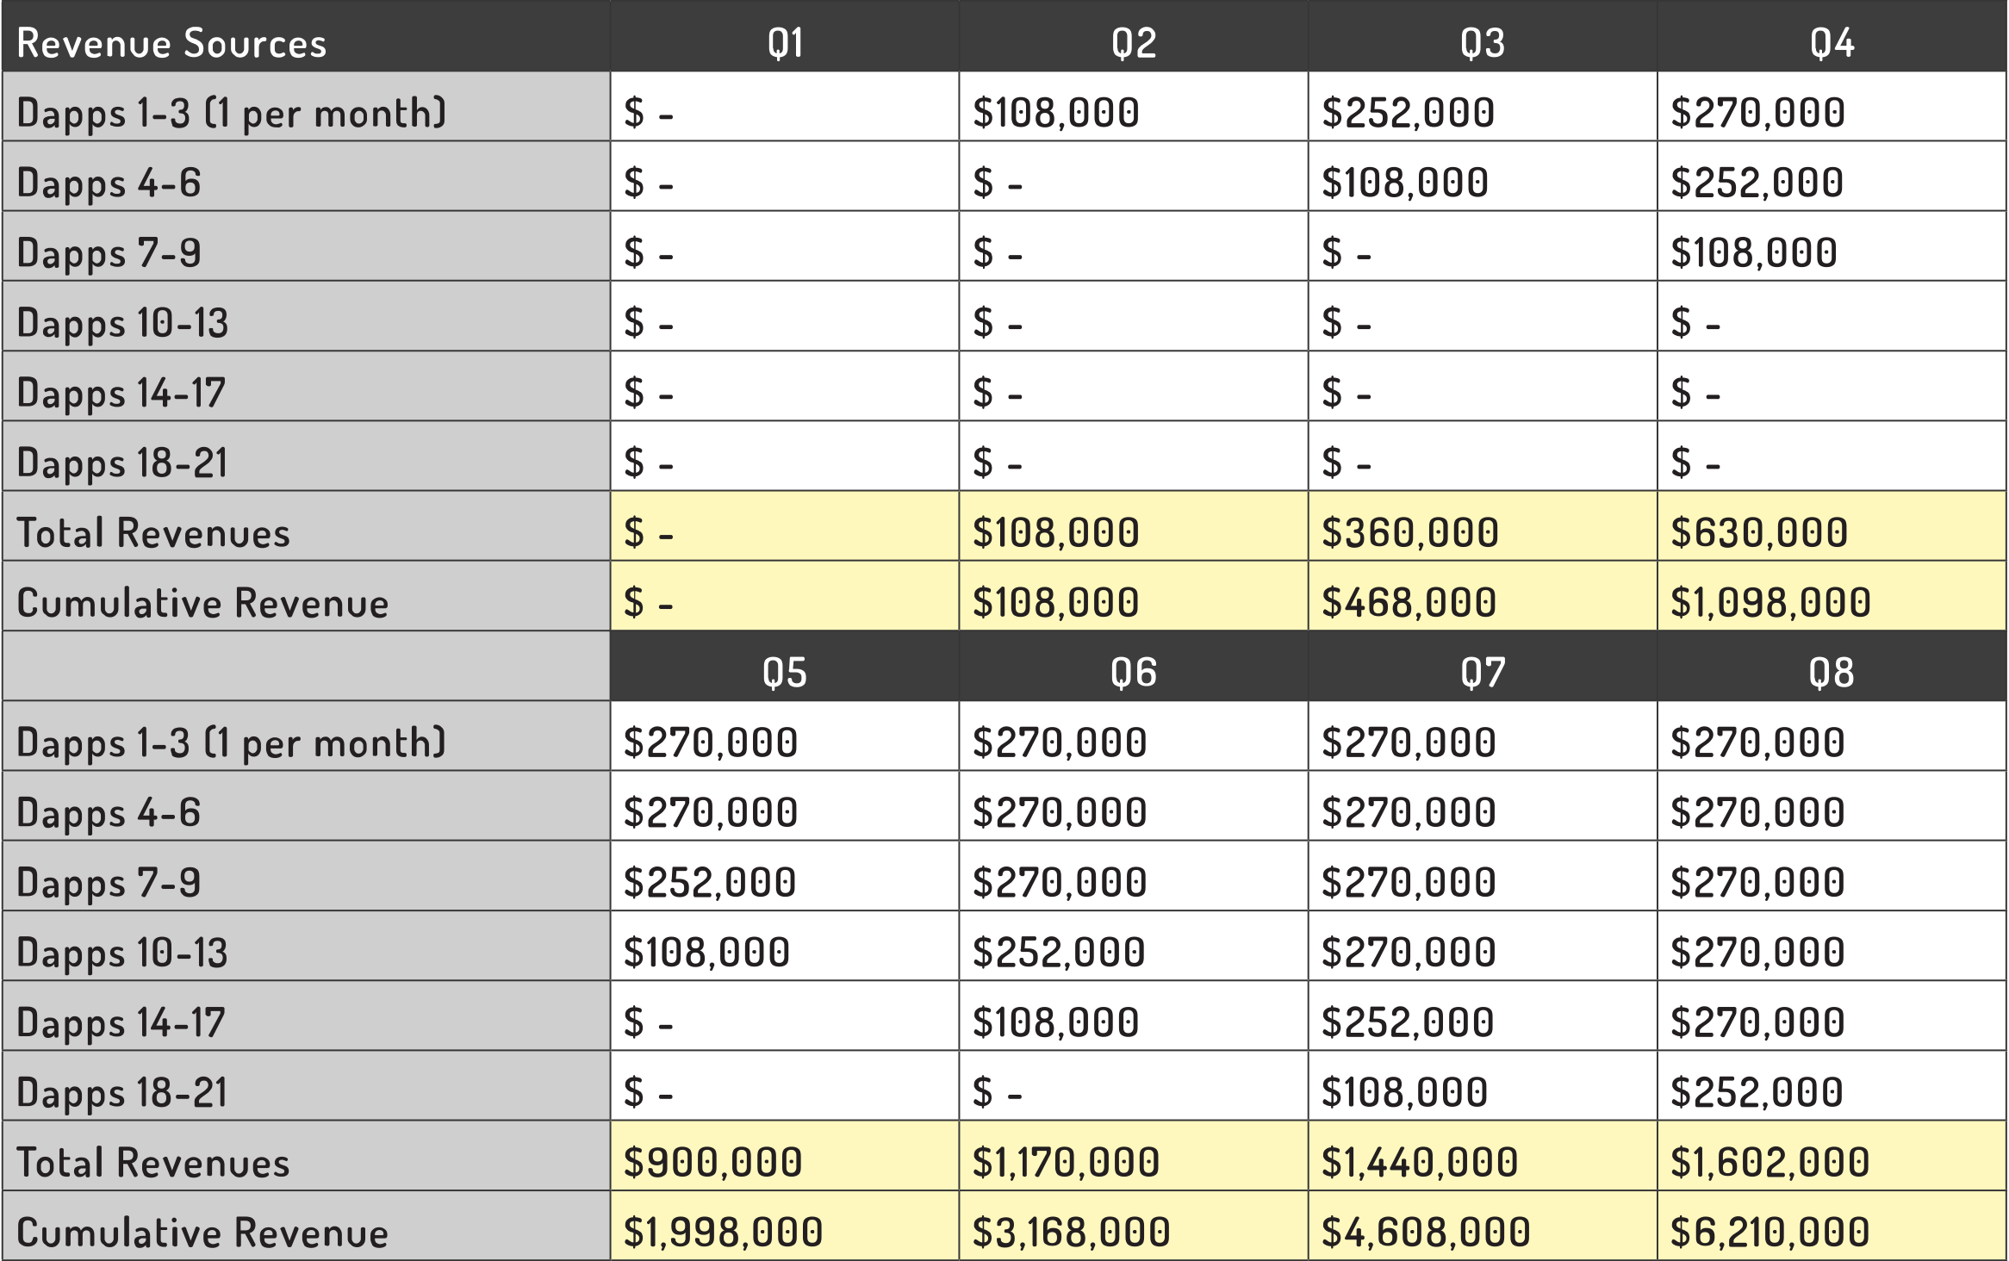
Economic Modeling Assumptions
Revenue
$4.8 MILLION
PROFIT/YEAR
This is a much bigger profit ratio than standard SaaS models

Slide 16
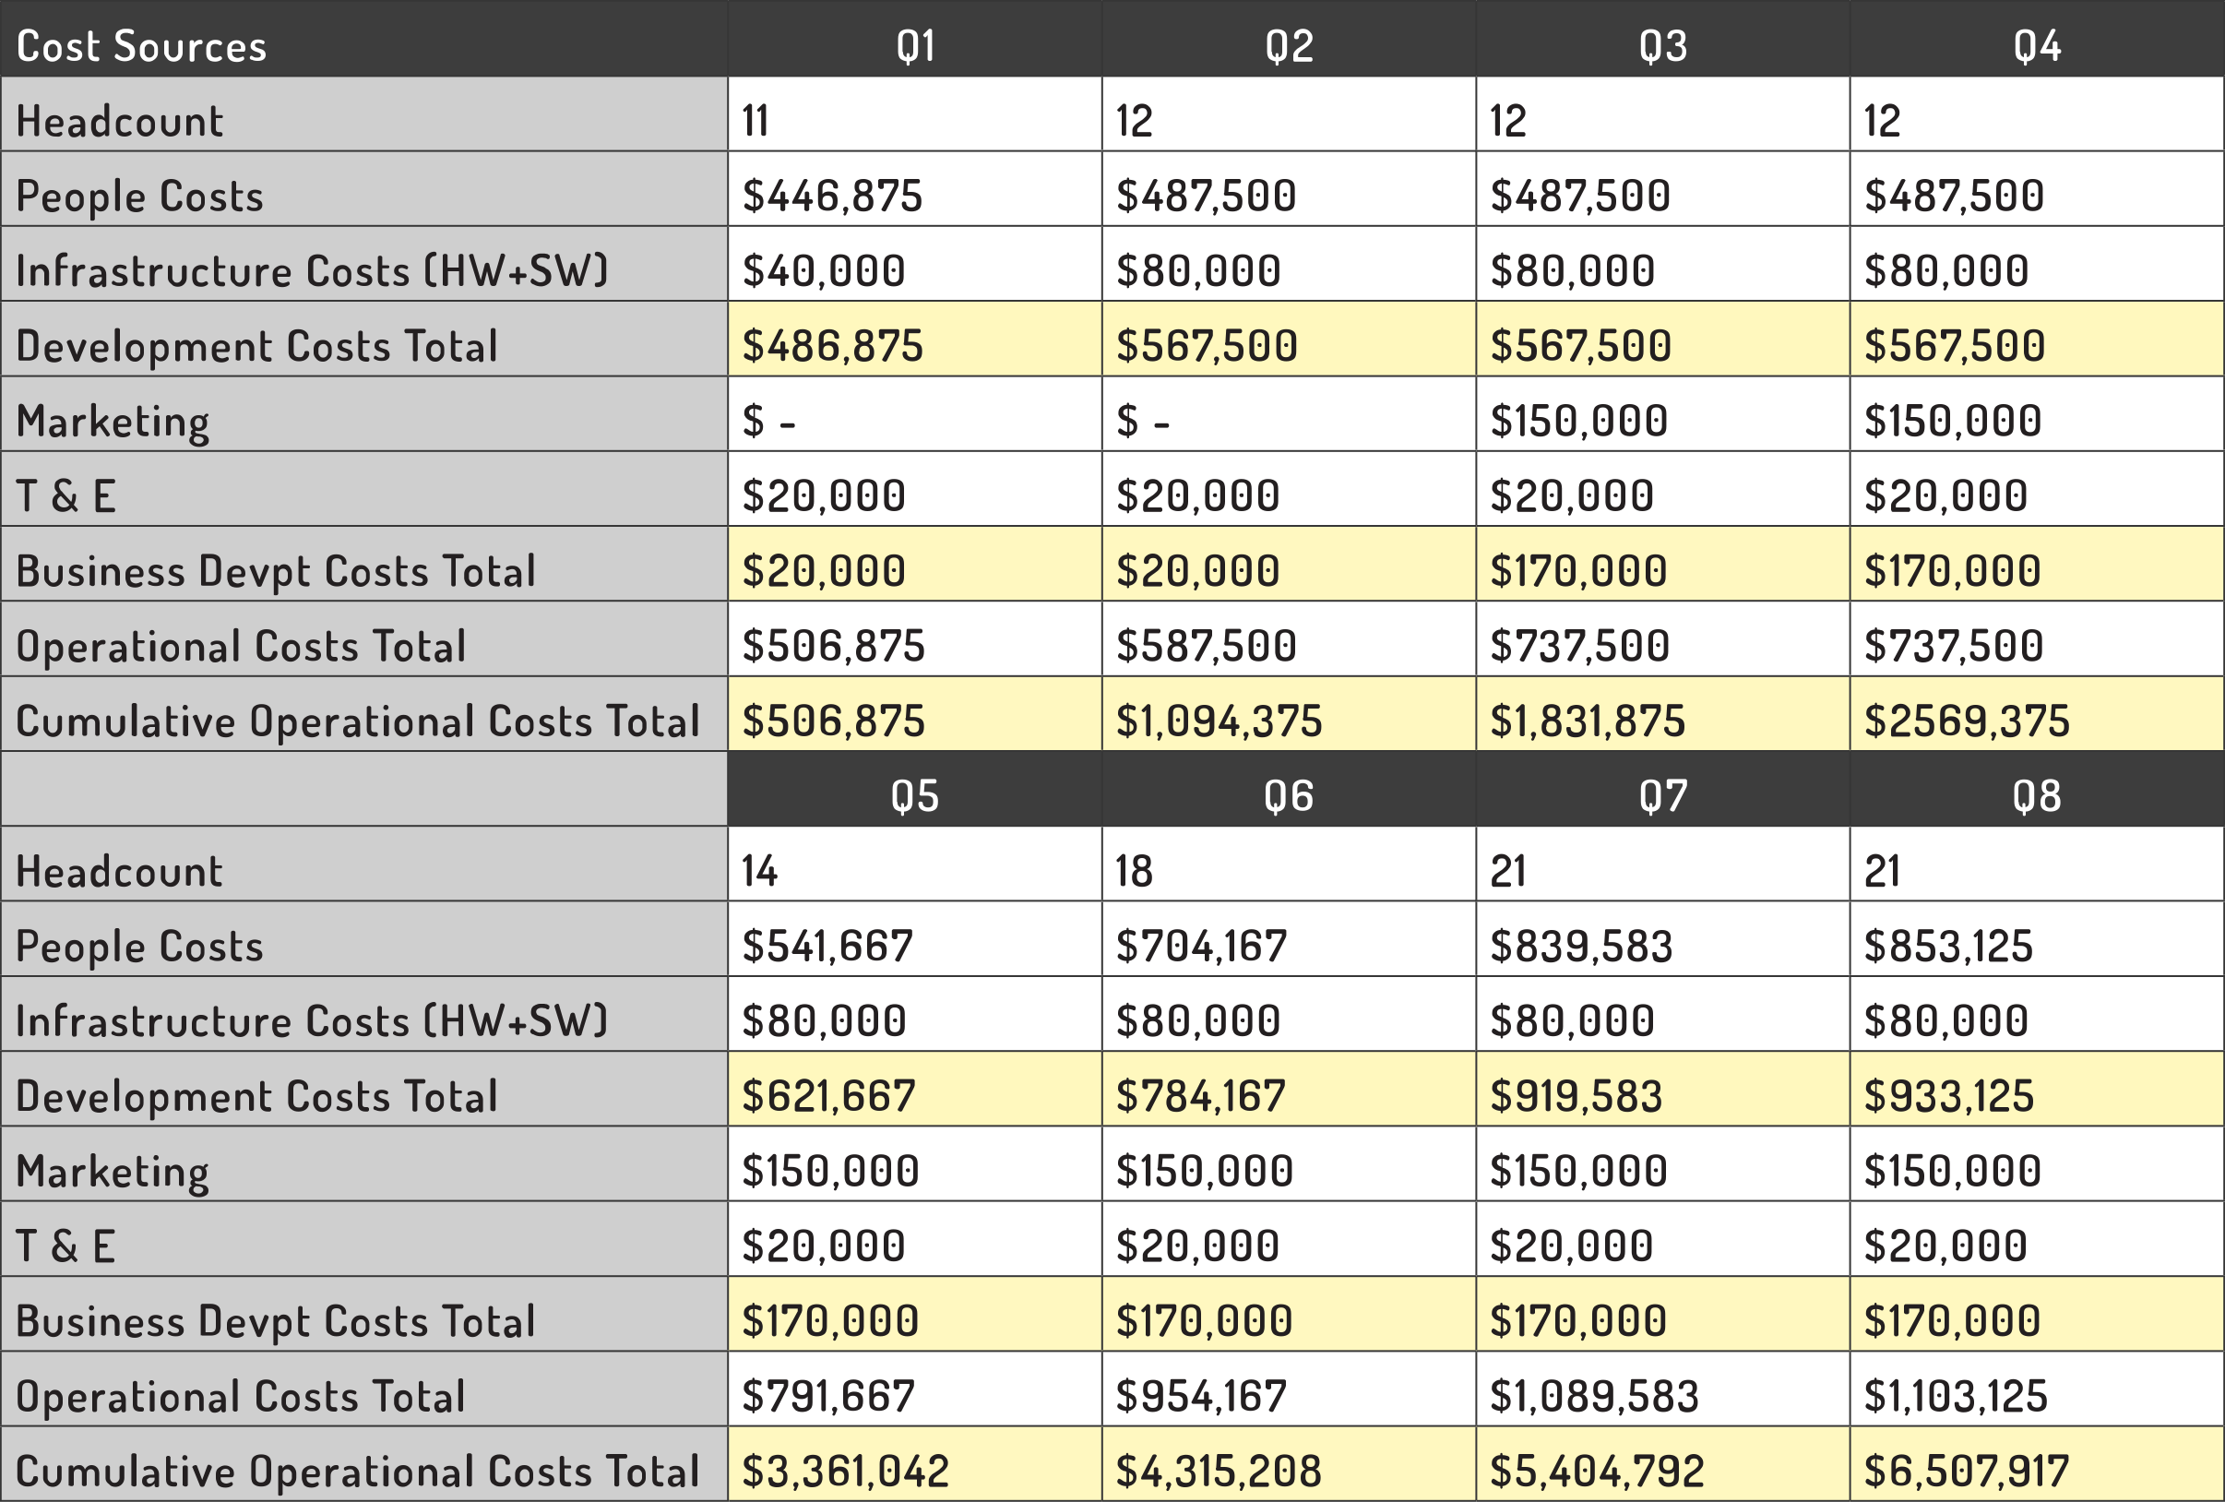
Economic Modeling Assumptions
Cost
$4.8 MILLION
PROFIT/YEAR
This is a much bigger profit ratio than standard SaaS models

Slide 17
Click To Play >> Click To Pay
It's an open field
There is no ad or sponsored content platform for dApps that can be considered decentralized Trust in Facebook and Google is waning.
The need to advertise and sponsor content is increasing.

Slide 18
Click To Play >> Click To Pay
DAASL will select applications that focus on digital asset management
Twitter, Facebook, lnstagram, Google, GMail, Google Maps are all click to play, with almost no click to pay events.
The economies created by these applications are bigger than the oil markets in fact they are the largest economies in the world.

Slide 19

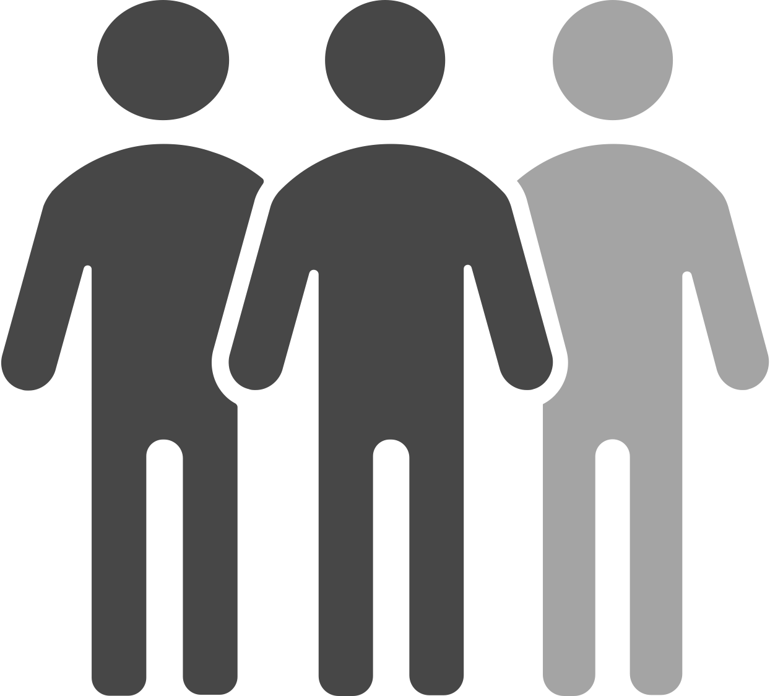

Click To Play >> Click To Pay
This is how end-users are already accustomed to using online apps
Users could pay per transactional event - too unwieldy
Users could pay a subscription - this will work for many, but not for all
User engagement could be sponsored - for the blockchain generation this must be differentiated from surveillance capitalism

Slide 20
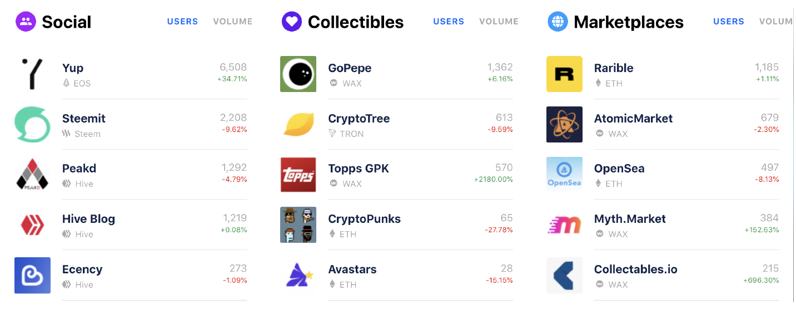




How It Works
DAASL focuses on dApps that create communities
Communities that self-identify and are willing to be sponsored have already provided key market data about the demographics they occupy
DAASL provides two different kinds of APls to dApps that use their platform
APls for the submission and delivery of sponsor's content to end users
APls for self-disclosure of additional key demographic data by end users to sponsors

Slide 21

How It Works
These APls uses two quantitative measures
Sponsorship tokens – DAASL
DAASL is transmittable and used
to convey value associated with sponsored content
Influence measure – Esteem
Esteem is not transmittable but used to measure when content is coming from valued sources
All on-chain content is given an index having a positive DAASL component and a positive Esteem component
Every dApp request for a "page" of content comes with identified "dApp shelf space" with abstract "locations" in the dApp "page" that are each given an index having a negative DAASL component and a negative Esteem component
Content is matched to locations by matching the indexes

Slide 22
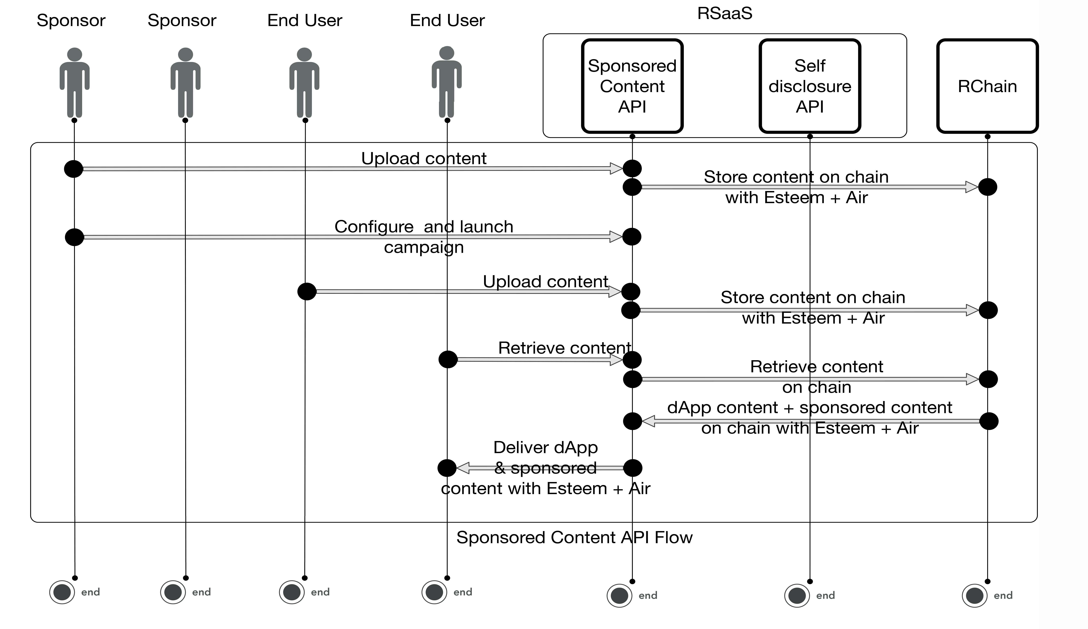
How It Works

Slide 23
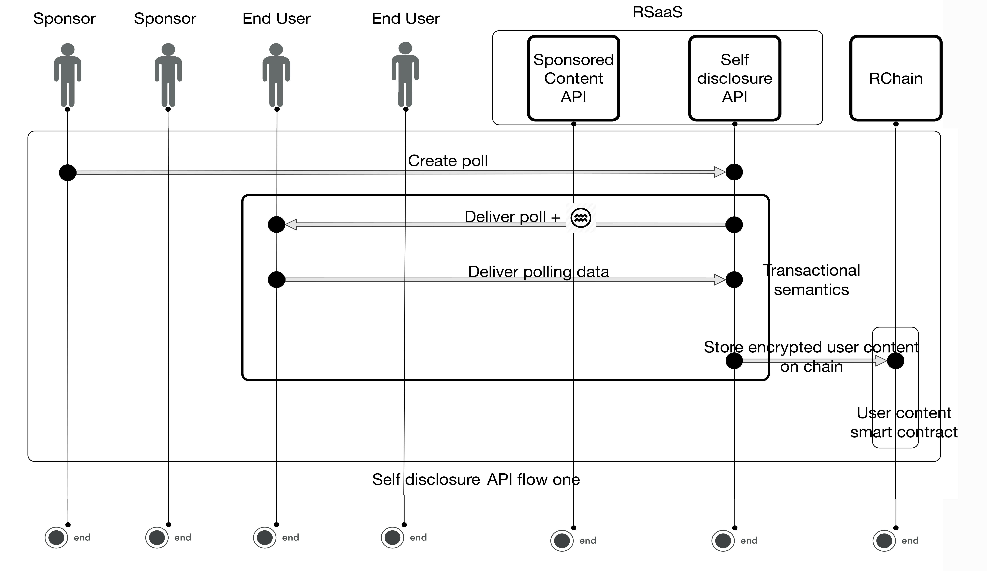
How It Works

Slide 24
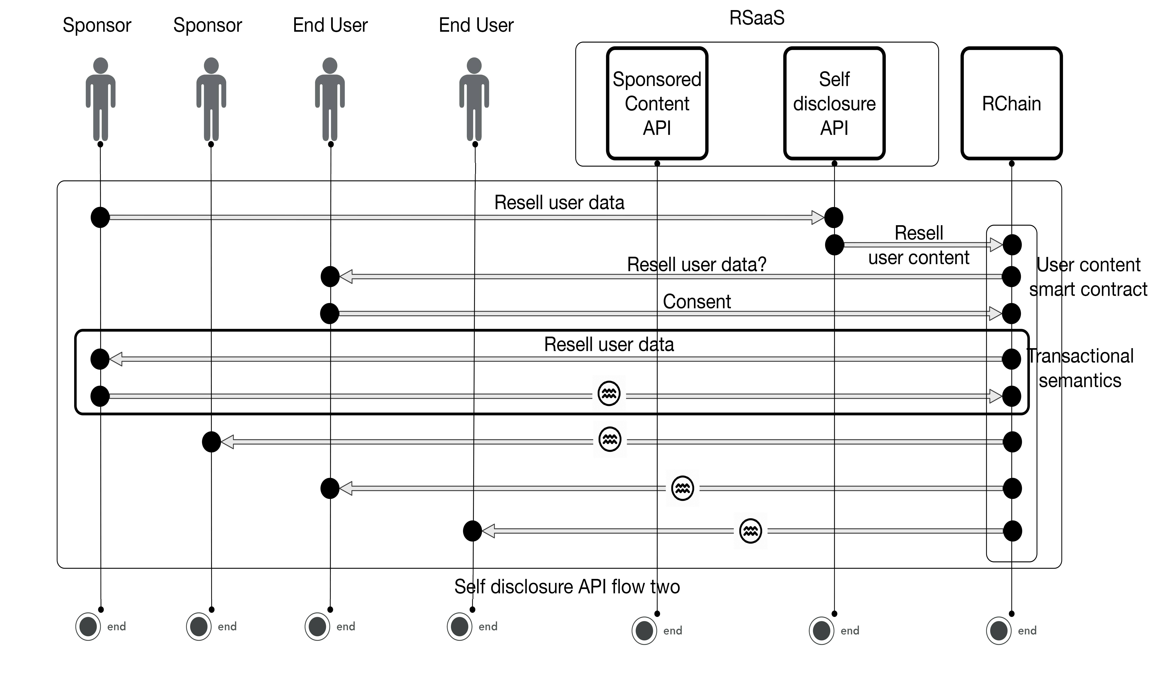
How It Works

Slide 25
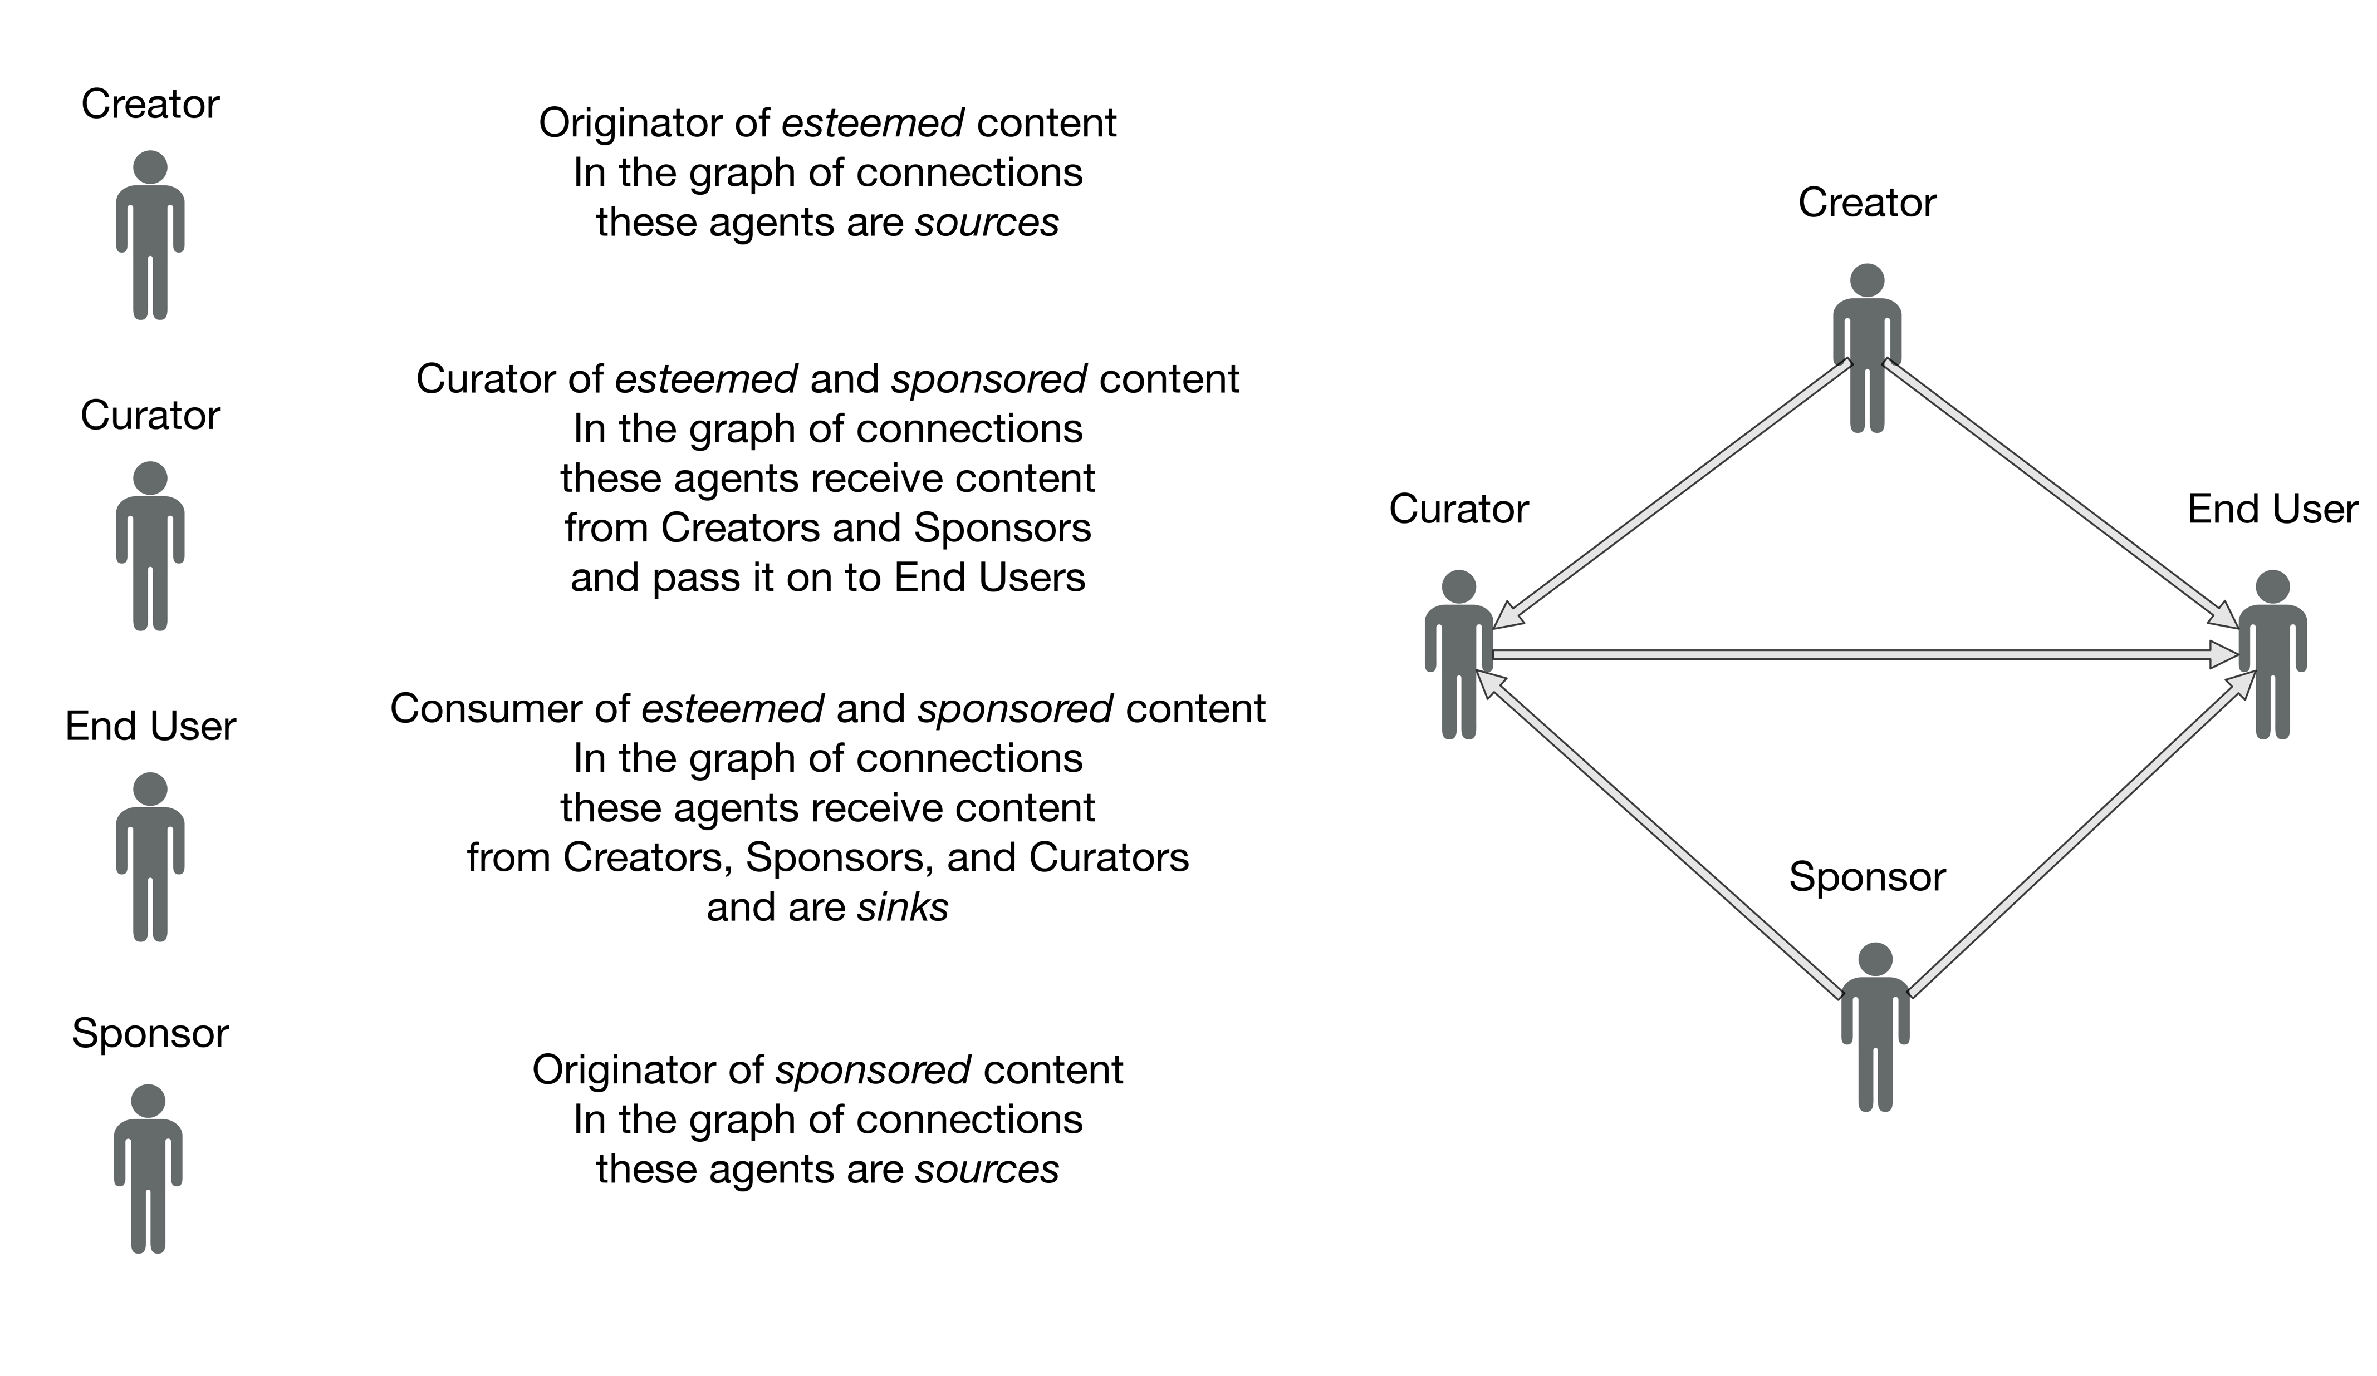
How It Works

Slide 26
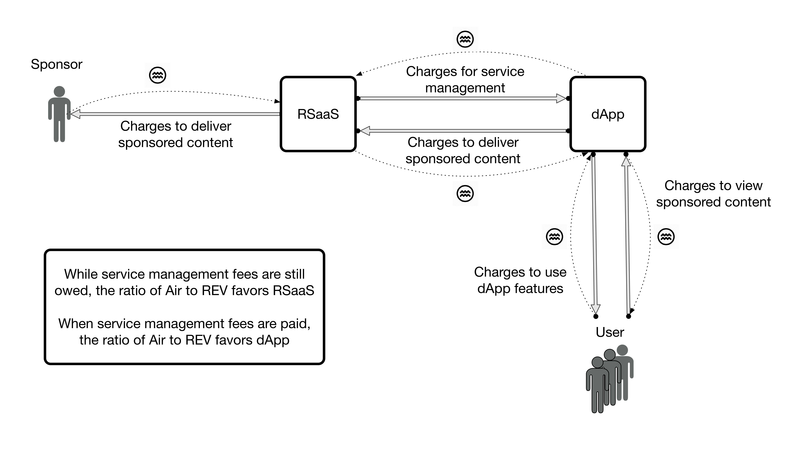
How It Works
DAASL
DAASL

Slide 27
How It Works
Economic modeling assumptions
Revenue assumptions
4 locations /page
40 impressions/day/user $0.02 /impression
Generating $5.84M revenue /year
Cost assumptions
4 engineers
1 managers /20 dApps
2 backup engineers /20 dApps costing $875K /year
Rounding up to $1 M
Expected return
$4.84M profit/year
This doubles the profit per year

Slide 28
How It Works
Predictive analytics
Web 2.0 also showed us that while 140 characters is useless as a single data point a stream of millions of these can be data-mined to yield incredibly valuable trends.
Blockchain collects streams of transactional data, the mining of which has not even begun to be explored.
Once data is stored on chain and all click-to-play events become transactions recorded on chain then predictive analytics have an entirely new kind of data to mine.
Beyond that, analysis of smart contracts provides provides an even deeper and richer vein to mine.

Slide 29
How It Works
Predictive analytics
It’s not only that DAASL has access to new data streams. It also has access to new data mining techniques..
Because click-to-play becomes transactional and coupled with smart contracts DAASL analytics has access to causal information and can thus use the techniques developed by Pearl and others to answer entirely new classes of questions.
This allows sponsors to probe intervention strategies and counterfactuals (what ifs).

Slide 30
How It Works
Predictive analytics
Sponsors will pay a premium for predictive analytics that oﬀer insights using this new data.
Recursively, in DAASL these analytics become smart contracts.
These new forms of predictive analytic smart contracts are paid for in DAASL.

Slide 31


How It Works
DAASL also acts as an arbitrage mechanism amongst the platform tokens
On the backend dApp transactions must be paid for in platform tokens.
For example,
Specifically, each dApp needs platform tokens to run platform transactions but they pay DAASL to manage the token supply

Slide 32
Summary
We are offering an opportunity to invest in a for profit organization that provides both a sponsored content framework for empowered advertising ( called Rad-vertising) that executes on RChain's blockchain able to deliver trusted sponsored content to any dApp on any blockchain to internet scale and ensures those dApps keep running.
We are offering a sustainable return on an investment of $1 M of 12% of profits which would be expected to return an ROI of X0/o over 5 years.
Alternatively we are offering a purchase of utility tokens or a combination of both such that the utility tokens represent smart money for sponsored content campaigns.

Slide 33
Thank You

